Slide 1


Group B7
DATA
COMPRESSOR
CIRCUIT

Slide 2



Ahmad Rifqi
Michael Winston Tjahaja
Laode Alif Masum
Mochammad Dyenta Dwiantomitara
Meet
the
Players

Slide 3

introduction
BACKGROUND
To improve the efficiency and reliability of data transmission by reducing the amount of data that is transmitted normally
PROJECT DESCRIPTION
To count the number of repetitions of a given data string,
To reset the count when the data string changes.
OBJECTIVE
To reduce the size of data that is passed through a network
To increase the success rate transmission of data
To make the process of transmitting data more efficient
ROLES AND RESPONSIBILITIES
Main Coding of the project, Test Bench Creation, ModelSim Simulation, Report, Quartus Prime Model, Power Point Presentation

Slide 4





Equipment

Slide 5
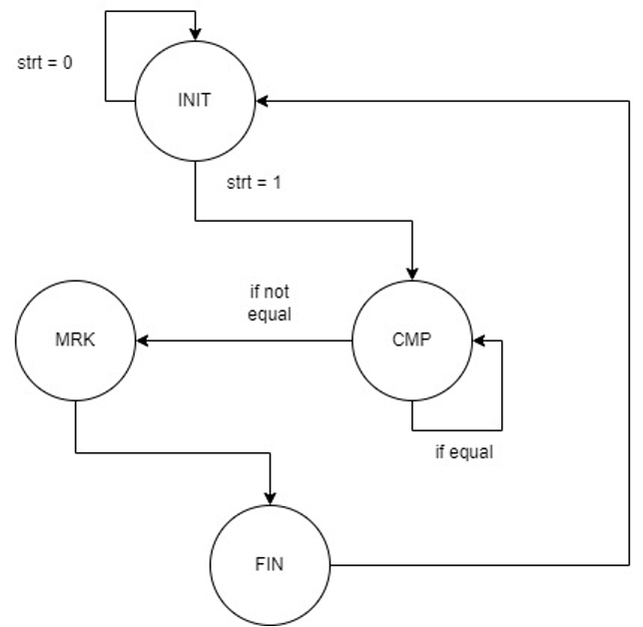
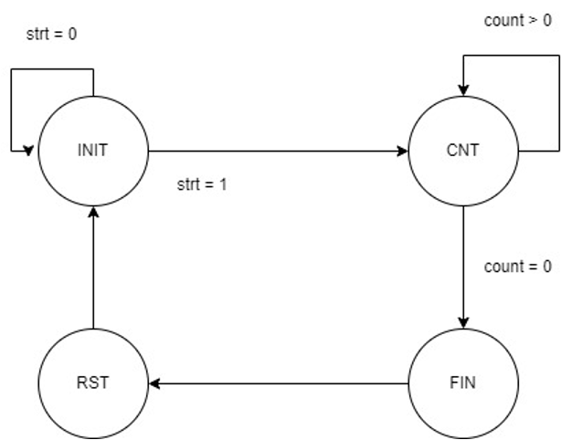
Implementation
Encoder schematic
Decoder schematic

Slide 6
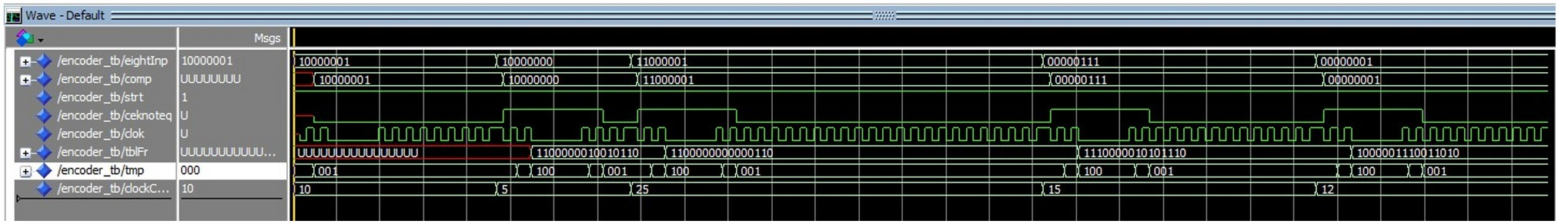
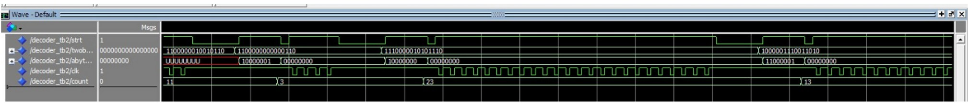
Testing
&Result
Wave Simulation for Encoder
Wave Simulation for Decoder

Slide 7
Analysis
The main circuit has 4 states where it will go through each state and be able to decompress data bits according to the sequence it presents itself in. Within the INIT state, the count will be set to 1 whenever a new data bit is sent into the input. An input of 8 bits will be assigned momentarily into the memory. Then it moves to a new state, CMP, where the new bit of data will be compared with the input within the buffer and compared. If the second bit combination matches with the input within the buffer, the count variable will be incremented. The circuit will then detect whether a repetition occurs once or more within the MRK state. If it only occurs once, the tag value will be 0, and if it does occur more than once, the tag value will be 1. The tag is used to prevent wasting 8 bits of space if the sequence frequency only occurs once. The circuit will then finally enter the FIN state where the tag (1 bit), the original sequence (8 bits), and the frequency (7 bits) are concatenated to form a 16-bit output that will be transmitted towards the internet.

Slide 8
Conclusion
The encoder and decoder circuit functions as desired and meets the goals of its creation.
There are some improvements that can be made for this circuit including increasing the flexibility of the decoder input length to accommodate graphic based data like photos or videos, implementing parallelism to reduce the time needed to process data, as well as other improvements

Slide 9
References
Prasetyo, H. (2022, November 13). Algoritma run length encoding compression. Hendro Prasetyo. Retrieved December 10, 2022, from https://hendroprasetyo.com/memahami-algoritma-run-length-encoding-compressi/
Charles H. Roth, L.K. John, Digital System Design Using VHDL, 2nd edition. Austin,TX: Thomson, 2008
Universitas Indonesia. (2021). Perancangan Sistem Digital Modul 9: Finite State Machine. [PDF File]. Available: https://emas.ui.ac.id/mod/resource/view.php?id=962413
Universitas Indonesia. (2021). Perancangan Sistem Digital Modul 8: Looping Constuct. [PDF File]. Available: https://emas.ui.ac.id/mod/resource/view.php?id=962413
Universitas Indonesia. (2021). Perancangan Sistem Digital Modul 6: Testbench. [PDF File]. Available: https://emas.ui.ac.id/mod/resource/view.php? id=962413
Universitas Indonesia. (2021). Perancangan Sistem Digital Modul 5: Structural Circuit Design. [PDF File]. Available: https://emas.ui.ac.id/mod/resource/view.php?id=962413
Universitas Indonesia. (2021). Perancangan Sistem Digital Modul 4: Behavioral Circuit Design. [PDF File]. Available: https://emas.ui.ac.id/mod/resource/view.php?id=962413
Universitas Indonesia. (2021). Perancangan Sistem Digital Modul 3: Concurrent Circuit Design. [PDF File]. Available: https://emas.ui.ac.id/mod/resource/view.php?id=962413
Universitas Indonesia. (2021). Perancangan Sistem Digital Modul 2: VHDL Introduction. [PDF File]. Available: https://emas.ui.ac.id/mod/resource/view.php?id=962413

